Slide 1

TC4960J
Advanced Technical
Communication
Product Satisfaction and Buyback Intention Prediction based on Review Analysis
Name: Yanzhuo Cao; Email: yanzhuo@umich.edu

Slide 2
Introduction

Slide 3
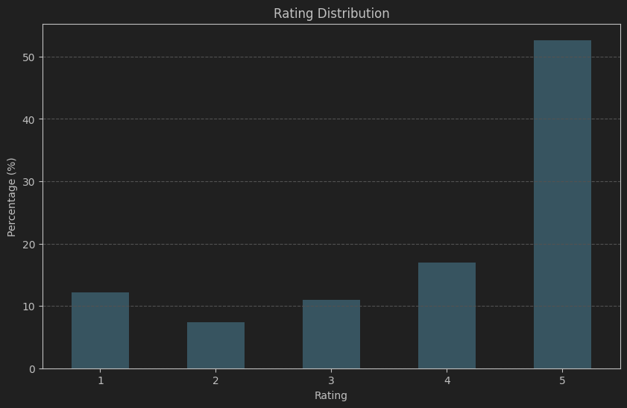
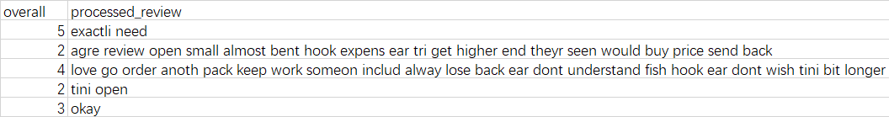
Sentiment Analysis Enhances Customer Insights
Sentiment analysis plays a vital role in interpreting customer feedback on e-commerce platforms [2]. This project explores machine learning techniques to predict numerical customer ratings from textual reviews using the "Amazon Product Review Dataset" from UC San Diago.
Previous research has highlighted the adaptability of sentiment analysis techniques in discerning customer sentiments from textual data [1]. However, traditional methods often rely on binary classification, overlooking the nuances in numerical ratings.
This project aims to bridge this gap by refining sentiment analysis for e-commerce, enhancing the predictive accuracy of customer ratings, and providing businesses with actionable insights into consumer preferences and satisfaction drivers.
Figure 1 & 2: Data Example and Rating Distribution

Slide 4
Problem & Solution

Slide 5
Traditional Methods Oversimplify Customer Feedback
Traditional sentiment analysis methods often fall short in capturing the subtleties of numerical ratings. They primarily rely on binary classification, which oversimplifies customer feedback.
This simplification leads to a loss of valuable information, as it fails to capture the nuances and depth of customer sentiments expressed through numerical ratings.
To address this challenge, it is essential to develop models that can accurately predict numerical ratings from textual reviews. By doing so, we can gain a more detailed understanding of customer feedback, helping businesses enhance customer satisfaction and loyalty.

Slide 6
Advanced models for accurate rating predictions
To address the limitations of traditional sentiment analysis, I propose developing advanced models to predict numerical ratings from textual reviews.
The models include:
- Convolutional Neural Networks (CNN): Captures local patterns in text using Word2Vec embeddings.
- Long Short-Term Memory (LSTM) networks: Processes text sequentially to preserve information over extended sequences.
- Transformer models: Uses multi-head attention mechanisms to capture global context in text.
These models are designed to analyze specific words and features that significantly influence customer ratings, providing actionable insights for businesses to improve customer satisfaction and loyalty.

Slide 7
Methods & Procedures

Slide 8

Method 1: Convolutional Neural Networks
Detailed Procedures
- Utilizes Word2Vec embeddings to convert text into vectors.
- Convolutional layers capture local patterns in the text.
- Global max pooling layer to down-sample and highlight significant features.
- Dropout regularization to prevent overfitting.
- Dense layers to predict numerical ratings.
Advantages:
- Effective in capturing local dependencies and patterns in text.
- Suitable for shorter text segments.
Figure 3: CNN Working Principle

Slide 9
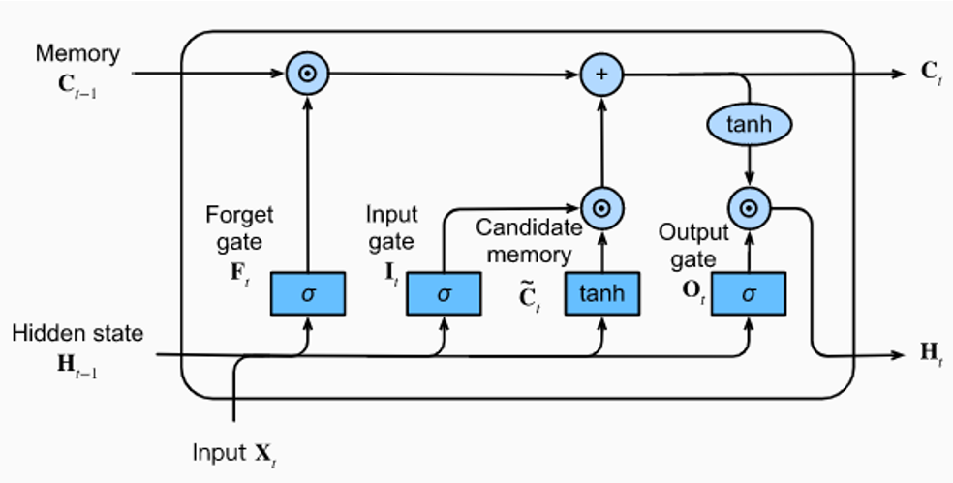
Method 2: Long Short-Term Memory Networks
Detailed Procedures
- Processes text sequentially, preserving long-term dependencies.
- LSTM layers handle extended sequences of text.
- Dropout layers to prevent overfitting.
- Dense layers for final sentiment prediction.
Advantages:
- Maintains context over long sequences.
- Effective for capturing the flow of sentiments within reviews.
Figure 4: LSTM Working Principle

Slide 10
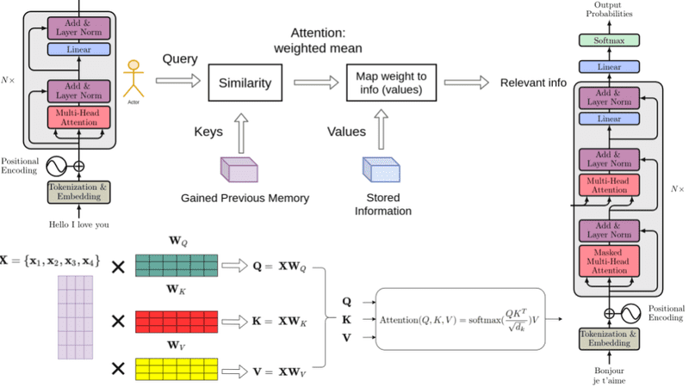
Method 3: Transformer Model
Detailed Procedures
- Uses multi-head attention mechanisms to capture global context.
- Positional encodings to maintain the order of words.
- Handles long sequences of text efficiently.
- Dense layers for final rating prediction.
Advantages:
- Captures global relationships and context.
- Efficient processing of long text sequences.
Figure 5: Transformer Working Principle

Slide 11
Outcome

Slide 12
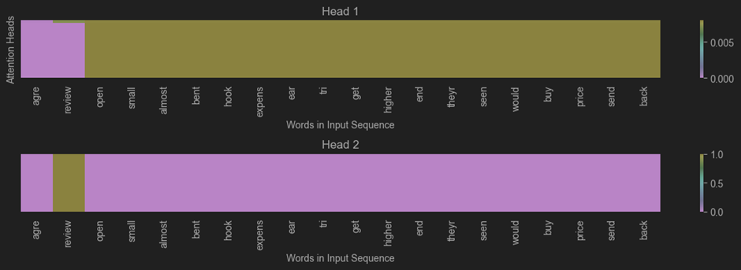
LSTM Models Achieve Superior Accuracy
Evaluation Metrics:
- Mean Absolute Error (MAE)
- Root Mean Square Error (RMSE)
Model Performance:
- LSTM: MAE = 1.20, RMSE = 1.61
- CNN: MAE = 1.50, RMSE = 1.97
- Transformer: MAE = 1.60, RMSE = 2.00
Key Findings:
- LSTM models demonstrated superior accuracy.
- Significant words impacting ratings: "comfort," "price," "material."
- Consistent improvement over baseline models.
Implications:
- Enhanced understanding of customer sentiment.
- Actionable insights for businesses to improve satisfaction and loyalty.
Figure 6: Attention Head Results

Slide 13
Implications

Slide 14
Actionable Insights for E-commerce and Research
For E-commerce Businesses:
- Deeper understanding of customer feedback.
- Identification of key areas for product and service improvement.
- Data-driven decisions to enhance customer satisfaction and loyalty.
For Academic Research:
- Advances in sentiment analysis techniques.
- Insights into effective models for predicting numerical ratings.
- Framework adaptable to other fields like healthcare, finance, and social media analysis.
Intellectual Merit:
- Contribution to the development of nuanced and interpretable sentiment analysis models.
- Empowerment of businesses and researchers to gain deeper insights into customer sentiments.

Slide 15
Future Work

Slide 16
Refinement and Expansion of Models
Model Refinement:
- Fine-tuning Transformer models for better accuracy.
- Experimenting with bidirectional LSTMs for improved context understanding.
Methodological Improvements:
- Incorporating unsupervised learning techniques to capture subtle nuances.
- Exploring ensemble methods to combine strengths of different models.
Application Expansion:
- Adapting the framework to other domains like healthcare and finance.
- Developing tools for real-time sentiment analysis on social media platforms.
Data and Evaluation:
- Expanding the dataset to include more diverse reviews.
- Continuously evaluating model performance and updating methodologies.

Slide 17
Conclusions

Slide 18
Refinement and Expansion of Models
Summary of Findings
- LSTM models demonstrated superior accuracy in predicting numerical ratings, with MAE = 1.20 and RMSE = 1.61.
- Key influencing words included "comfort," "price," and "material.“
Implications for E-commerce
- Provides deeper understanding of customer feedback.
- Helps identify key areas for product and service improvement.
- Enhances customer satisfaction and loyalty through data-driven decisions.
Academic Contributions
- Advances sentiment analysis techniques.
- Provides insights into effective models for predicting numerical ratings.
- Adaptable framework for other domains such as healthcare, finance, and social media analysis.
Future Directions
- Further optimize Transformer models and bidirectional LSTMs.
- Incorporate unsupervised learning techniques to capture subtle nuances.
- Expand the dataset and continuously evaluate model performance.

Slide 19
References

Slide 20
References
[1] Ni, J., Li, J., and McAuley, J. (2019). Justifying recommendations using distantly labeled reviews and fine-grained aspects. In Proceedings of the Empirical Methods in Natural Language Processing (EMNLP).
[2] Alibasic, A. and Popovic, T. (2021). Applying natural language processing to analyze customer satisfaction. pages 1–4

Slide 21

Thanks for Listening!

